Slide 1

Get Active Kids
Voucher Program
Round 11
September 2026

Slide 2


What is GAKV?
The Get Active Kids Vouchers Program launched in March 2021
Eligible children may receive up to $200 to cover the costs for community sport membership and registration fees.
Children must be aged 0 to 18 and named on a Health Care Card or Pensioner Concession Card and Medicare card to be eligible.
Over the first 10 rounds of the program Basketball has recorded the 2nd highest uptake of vouchers across all sports.
There is now the option of a voucher, for those yet to pay their registration or reimbursement for those who have already paid.

Slide 3
How Does it Work?
BV will act as the auspice organisation for ALL basketball providers. Clubs and Associations do not need to register as a Provider.
To reduce the administration burden and ensure clubs are reimbursed faster
Participants will select Basketball Victoria (Provider #2951096) when applying for a voucher
BV will run fortnightly clearing cycles and reimburse clubs/associations prior to receiving funds from SRV
BV will also ensure all groups are reimbursed correctly – club – association – BV
If your participants have used vouchers via PlayHQ and you haven’t previously completed a bank confirmation form or your bank details have changed, you can do so here to ensure you are reimbursed accordingly
GetActiveKidsVoucherBankConfirmationForm

Slide 4
How Does it Work?
VOUCHER OPTION
Applicants can apply for a voucher prior to registering and use this voucher to discount their registration fees
https://www.getactive.vic.gov.au/vouchers/apply-for-vouchers/
If eligible, receive a voucher code
Register and pay via PlayHQ where they will enter the voucher code and reduce the cost of their registration and/or membership fee by up to $200
If you’re club does not take registration payment via PlayHQ you can still accept the voucher and provide the discount. BV will accept vouchers taken outside the system by completing this form – GetActiveKidsVoucherReimbursement

Slide 5
How Does it Work?
PlayHQ have turned on the voucher functionality for all clubs and associations
Participant enters the voucher code on the final ‘Checkout’ page of registration
The registration fee will be discounted by up to $200
BV will manage the remainder of the process and reimburse clubs/associations up to the value of the voucher.

Slide 6
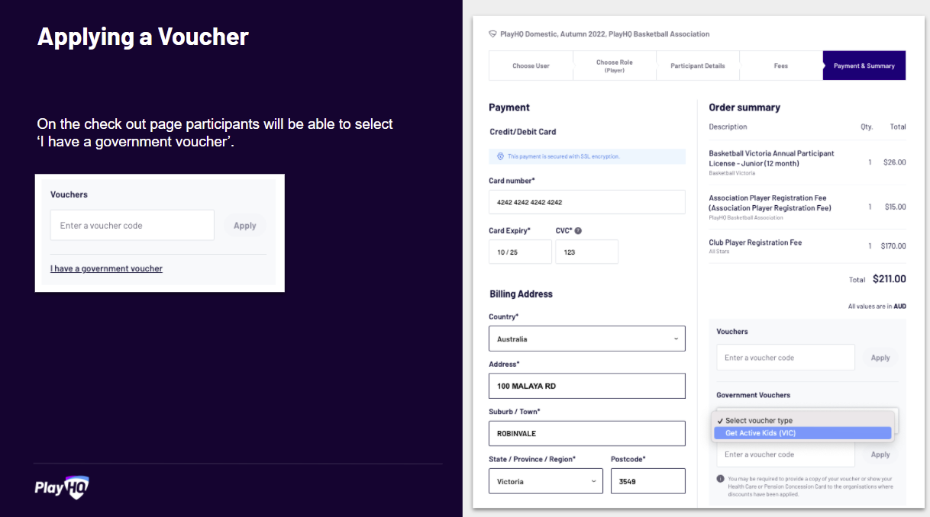
How Does it Look?

Slide 7
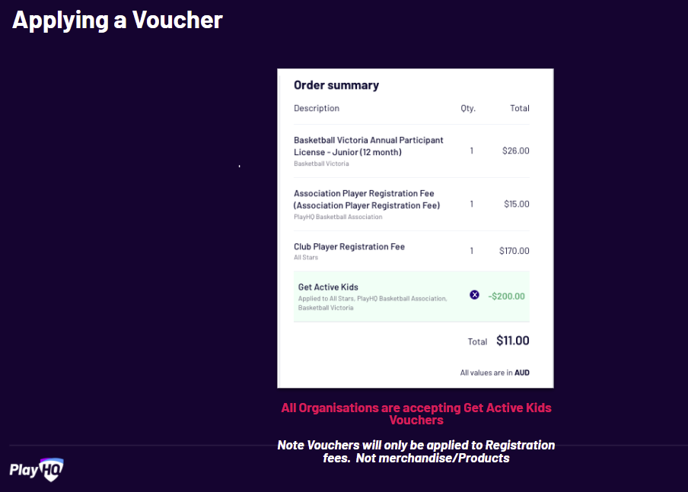
How Does it Look?

Slide 8
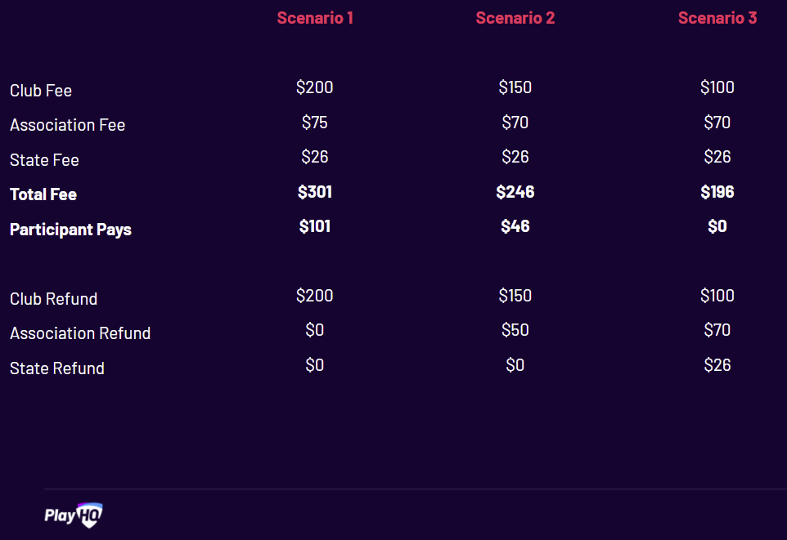
How Does it Look?

Slide 9
How Does it Work?
REIMBURSMENT OPTION
Applicants who have already paid registration fees can apply to be directly reimbursed by Get Active Kids
https://www.getactive.vic.gov.au/vouchers/apply-for-vouchers/ then selecting ‘Get Reimbursed’
If eligible, they will be directly reimbursed by Get Active Kids by up to $200

Slide 10
When Can We Claim?
BV will automatically process all vouchers claimed via PlayHQ
Associations and Clubs can claim anytime if the have accepted vouchers outside the PlayHQ system by completing the Organisation Claim Form
BV will process vouchers claims fortnightly and endeavour to process all verified claims with 5 business days of the end of each fortnight
Round 11 will open at 10am September 2026 and will close on 13 October 2026. All vouchers must be redeemed by Tuesday the 27th of April 2027.
Reimbursement expenditure dates are from 1 May 2026 until the reimbursement application date.
Questions –
Email - ben.pahl@basketballvictoria.com.au

